Slide 1



IBM Operational decision manager
Proof of concept playback 1
Nigel Crowther
^{9th} May 2023
transformingplanning.scot

Slide 2
CONTENTS
Context
Progress – Playback 1
Proof of concept
Helen Kershaw: Snr Solution Architect: Digital Planning Programme
helen.kershaw@gov.scot

Slide 3
POC Context

Slide 4
Business rules requirements
Abstract complex data driven business logic into a set of version controlled business rules, created once and consumed many times.
Business rules to be represented in near English notation open to user creation and management as opposed to IT creation and management.
Business rules to be supported by minimum IT involvement.
Business rules to be capable of consuming ReSTful services to obtain consumable data.
Business rule life cycle to be completely independent of the business application life cycle.
Business rules to be testable outside of the context of any business application.

Slide 5
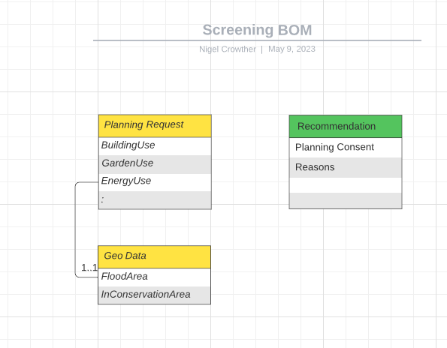
ODM Business Object MOdel

Slide 6
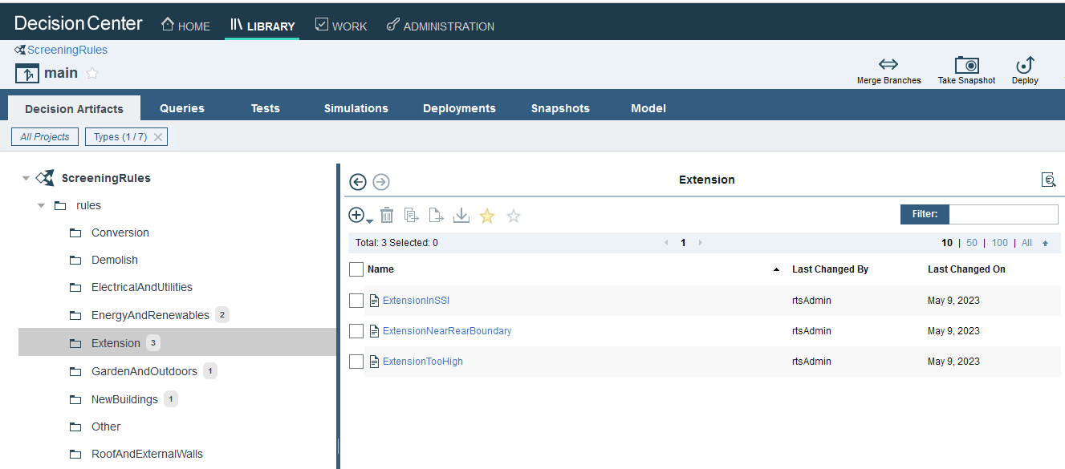
Business Rule Editing Environment

Slide 7
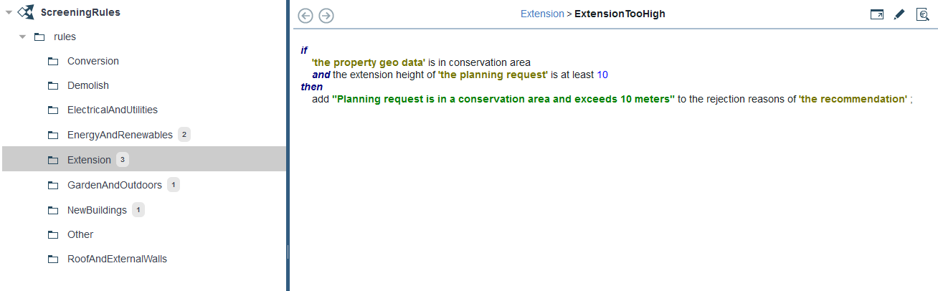
REQ: Business rules to be represented in near English notation open to user creation and management as opposed to IT creation and management.

Slide 8
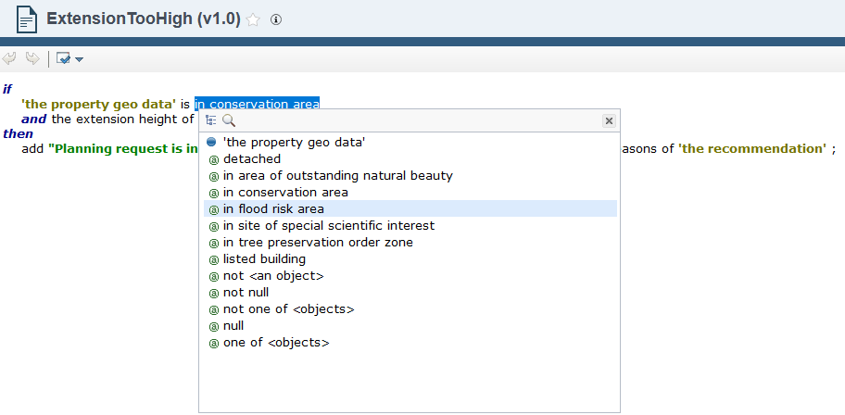
REQ: Business rules to be represented in near English notation open to user creation and management as opposed to IT creation and management.

Slide 9
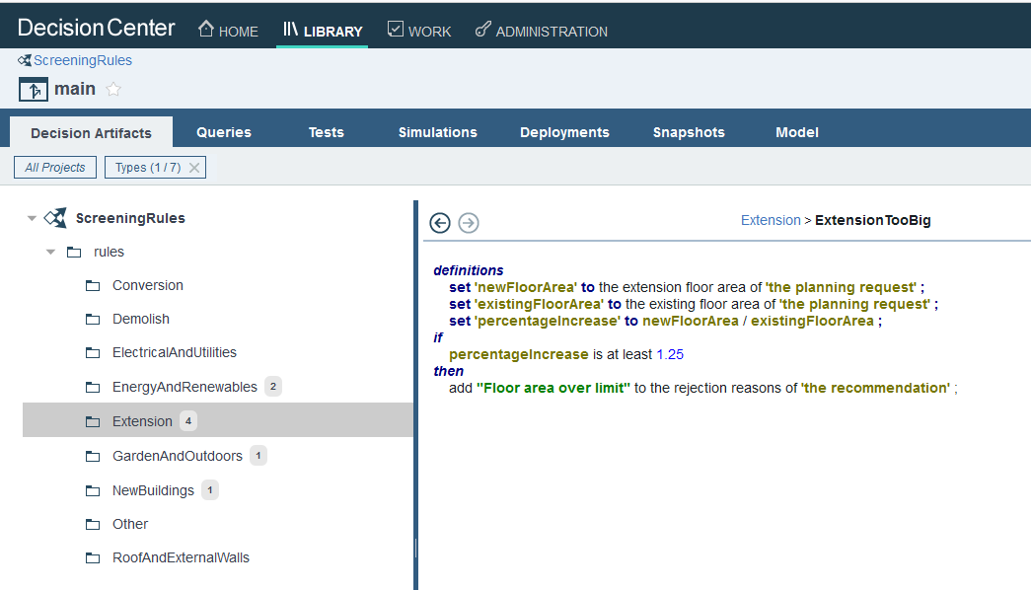
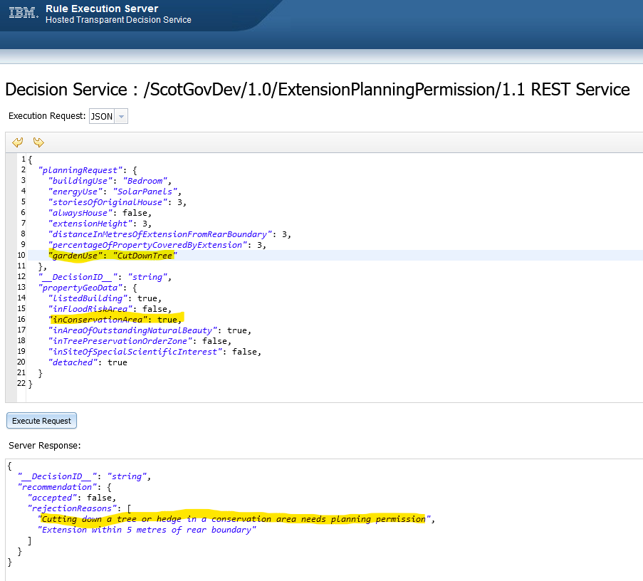
REQ: Business rules to be capable of consuming ReSTful services

